Slide 1

Ulaganathan | Vimal Raj | Dinakara lingam

Slide 2
Problem Statement
To reduce the carbon emission in Financial Crime Technology and achieve a 50% reduction of carbon footprint by 2025 as per our group commitment.
To reduce the current utilization, as we have already exceeded the target figure for this year, while the estimated annual carbon production was around 290,000kg.

Slide 3
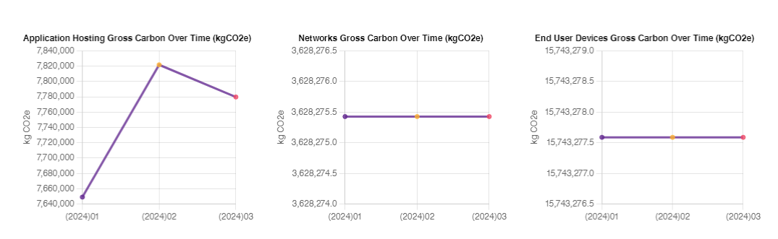
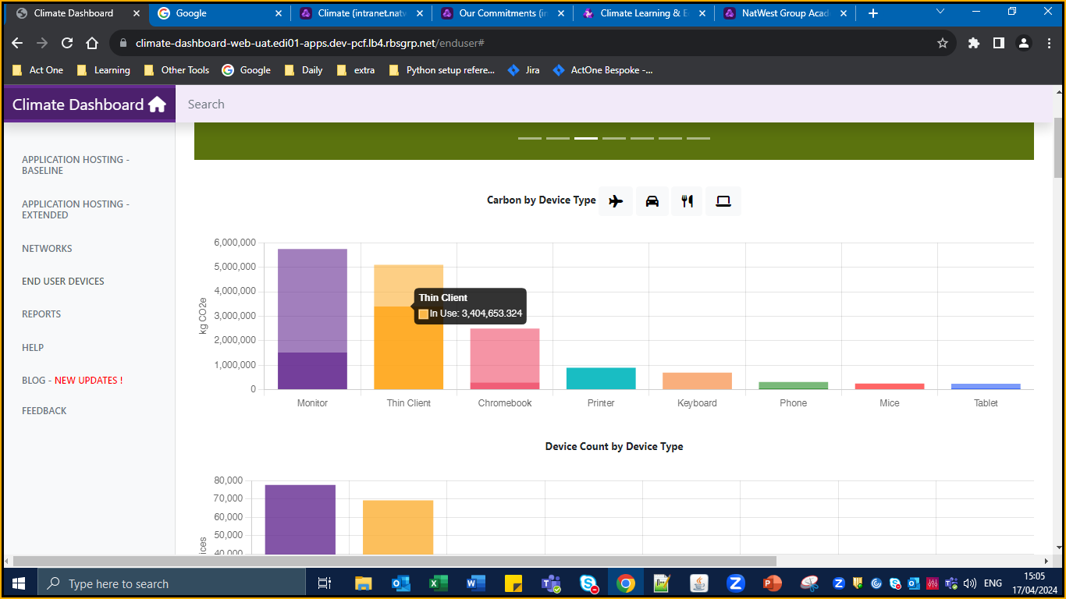
Analysis
As per climate dashboard – the major carbon emission is based on the End user Devices.
So, if we able to reduce a tiny amount of carbon emission in end user devices it will result in major difference.
If we further look down in the End User Devices – we could be able to identify that “Thin Client ” in usage itself contributes in 3,404,653.324 kgco2e.
Furthermore, analysis results in FUTRO S7011 results in overall emission of 1,517,703 kgco2e with usage of only 30,971 machines.
Total no: of Futro = 30,971.
Annual Carbon Emission by all the Futro = 1,517,703 kgco2e.
Single Futro emission for annual = 49.004 kgco2e.

Slide 4
Solution / Theoretical Calculations
Theoretical Calculation:
Based on the following formula for Annual emission we can calculate Energy consumption of single machine.
Annual Emission (kgCO2e) = Energy Consumption(kWh) x Carbon Emission Factor (Kgco2e/Kwh)
General Carbon Emission Factor of UK is 0.23314kgCo2e/kWh & For India is 0.82kgco2e/kwh
Energy Consumption (kWh) = 49.004 kgco2e / 0.82kgco2e/kwh
Overall Energy Consumption of a single machine is 59.76 kwh
As per Industrial Standards an ideal FUTRO S7011 needs to be consume nearly only 31.90 kwh annually, but we have consumed additionally 27.86kwh.
Also, as per FUTRO Datasheet – Sleep mode power consumption for the device is 1.62
Considering the machine will be in Sleep mode averagely for 10 hrs per day = 16.2
Considering for a year it results in 5.913 kwh.
If this 5.913 kwh is has been avoided from utilization by maintaining proper practices such as power down the specific areas when there is no people it
Annual Emission 1 machine = 44.154 kgco2e
Annual Emission by all machines = 1367493.534 kgco2e.
Practical and easy solution is to reduce the overall power consumption – but how can it be achieved?
Consider following parameter for the machine –
Total power consumption by the machine for a year.
Sleep power consumption

Slide 5
Benefits Achieved
01
Easy to implement
02
Reduction in cost of power consumption
03
No additional implementation required.
04
05

Slide 6
Future scopes and References

Slide 7
Thank You!!!

